Slide 1


A rework of the website for BUREAU OF INTERNAL REVENUE
Mini project -1
Presented by: Charmaine david

Slide 2

Concept
Optimization
Research
Planning

Slide 3
Technologies Used
HTML, CSS, JavaScript, Bootstrap, GitHub, GitBash
www.bir.gov.ph
w3school.com
Practical Code Academy (YouTube channel)
Adobe Photoshop for icons and logos
Codepen (To verify codes)

Slide 4





Concept
Background
Under the Department of Finance of the government of the Republic of the Philippines is the Bureau of Internal Revenue, which main objective is to collect taxes (internal revenue) from all taxable sources to fund all the activities of the government.
Services and how it is conducted
Currently, it conducts its operations both online and offline/manual.
For the online aspect, it has eFPS (Electronic Filing and Payment System) which makes filing and the payment of taxes more convenient.

Slide 5
Concept
Reason for the rework
The current state of the website is very outdated and very cluttered with a lot of things that may overwhelm its users.
The objective of this rework is to make it look modern, simpler, and make the usage of the website more intuitive.
Features
In addition, the chat bot has been fixed in such a way that it won’t send you back to the home page and let’s you continue browsing the current page you are currently viewing.

Slide 6
Concept
Considerations made
The color scheme used is green since according to studies, has a calming effect on its viewers.
Most of the website users are accountants so the UI is made as simple as possible and with less moving components/background details.
The website has also been tested with users with dyslexia and color-blindedness.
According to the subjects, the font used helped let them read the text properly.
The color scheme and contrast has also been said to be visible to the color blind subjects.

Slide 7
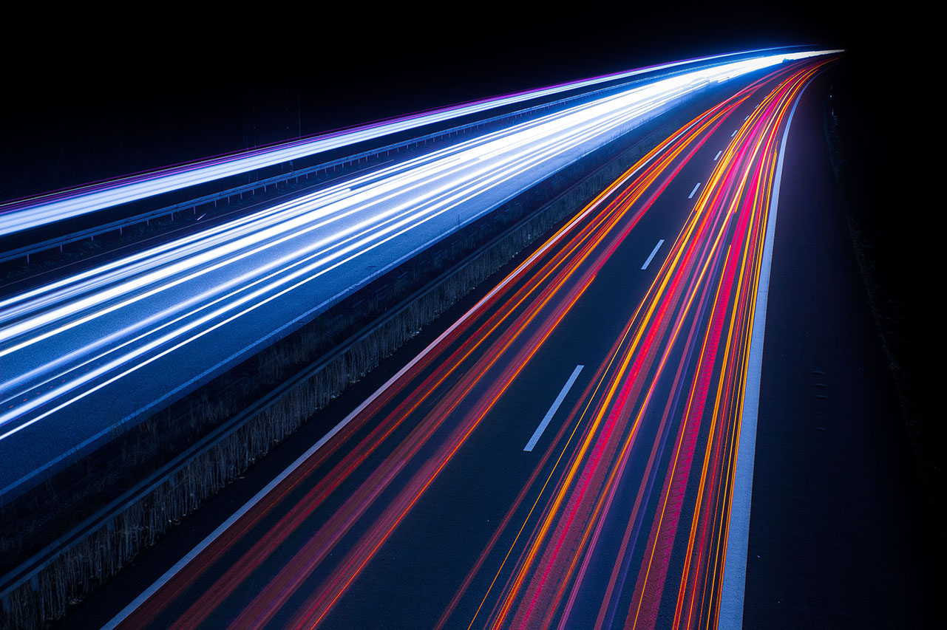
Thank You!
https://charnoodle.github.io/MP1-official

